Slide 1

User Authentication System
Using Image & Audio

Slide 2
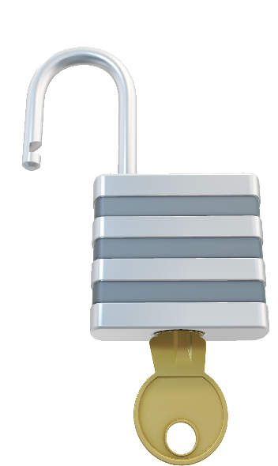
Executive Summary
In this day and age with cybersecurity becoming increasingly critical within the Fintech space, it is vital to come up with more creative ideas for user authentication and enhanced security
To accomplish this task, Machine Learning represents a unique opportunity. ML can be used to identify a user based on collected data.

Slide 3
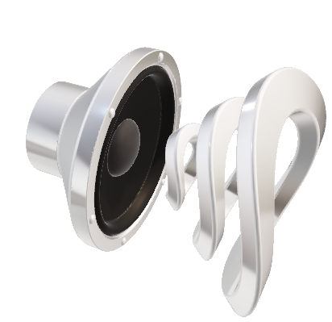

Selected Models
Image Classification (identifying images)
CNN (Convolutional Neural Network), Deep Learning
Plethora of documentation on image classification using CNN which shows promising nature of the algorithm/model
Audio Classification (audio identification)
Tensorflow Sequential Model – Deep Learning model that is used for speaker voice recognition (recognize each speaker in data set)
There is extremely limited opensource access to speaker identification models (only major corporations use it currently and is treated more as a business secret). This leaves you with Tensorflow with the downside of having to use copious amounts of data for valid predictions

Slide 4
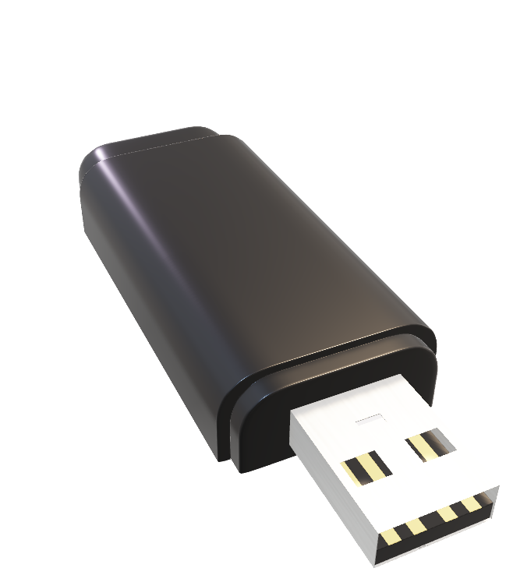
Data Prep
Image Classification
Downloaded over 50 selfies via Google extension
Downloaded 50 of my own selfies
Needed to verify that the program could differentiate my face from a stranger’s
Data ingestion using cv2 (this reads the images and converts each into a numpy array so that they are all the same size)
Split data into training ---> validation (confirming if close enough to prediction) --- > test sets
Created batches of images to be processed for training
Audio Classification
Used openslr.org to download 1000 hrs of speech recordings with over 200 speakers
Split data into train ---> validate --->test (70:20:10 split)
Extract features from audio (feature extraction) – the program, librosa library, is used to identify signatures in the voice
Add labels to each audio file (identifying each audio as the appropriate speaker)
Categorize each speaker using Hot Encoding (a method to organize or assigns a code to a category)
Then ready to be processed for training!

Slide 5
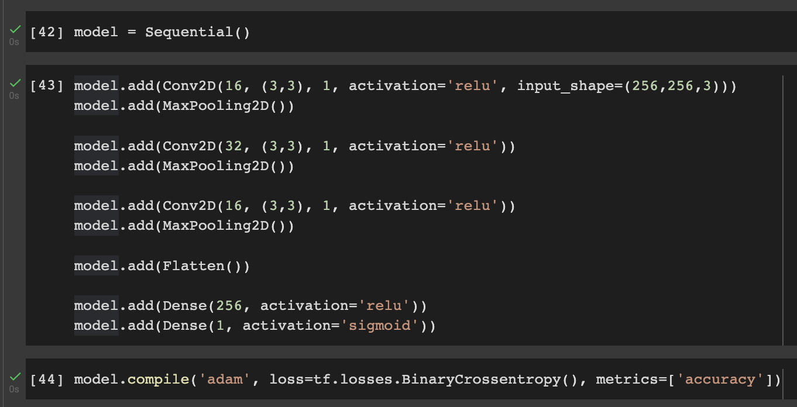

Training Process
CNN Image Classifier
Created 2D Convolutional Neural Network with 4 layers (see below)
Compile model using “adam” optimizer with BinaryCrossentropy loss function (used for classification problems with 2 categories)

Slide 6
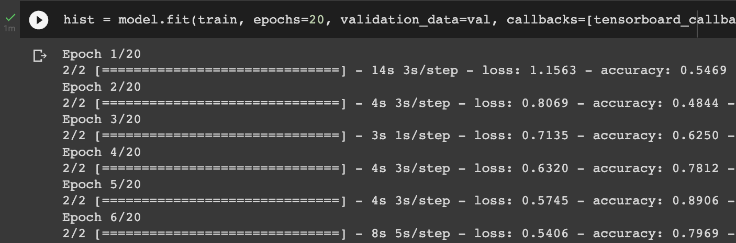
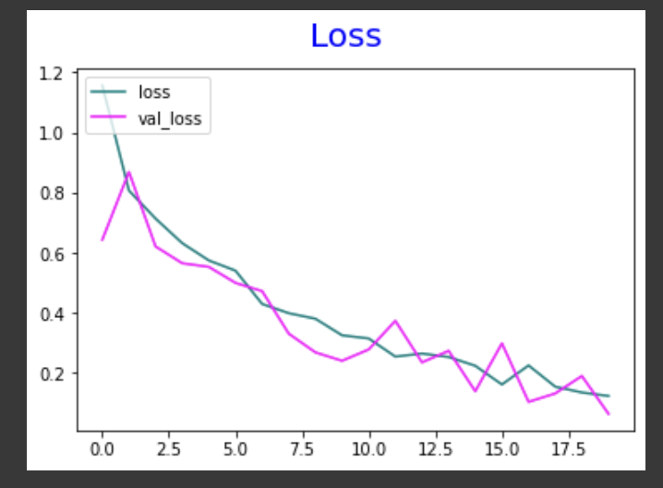
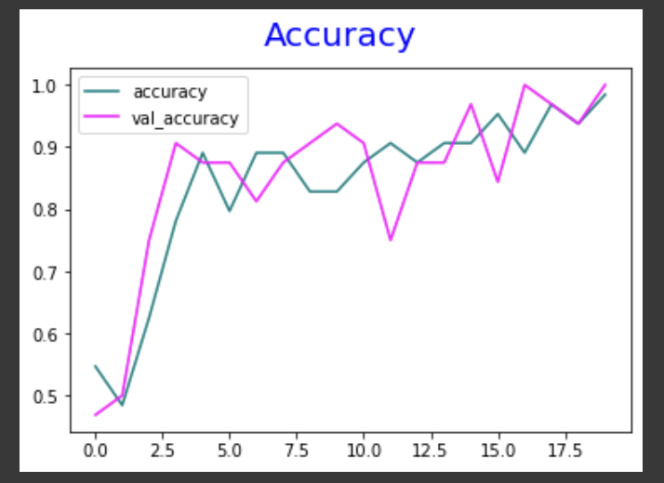

Training Process
CNN Image Classifier
Train model using model.fit function (see below)
Visually inspect model performance once training is complete (see charts)

Slide 7
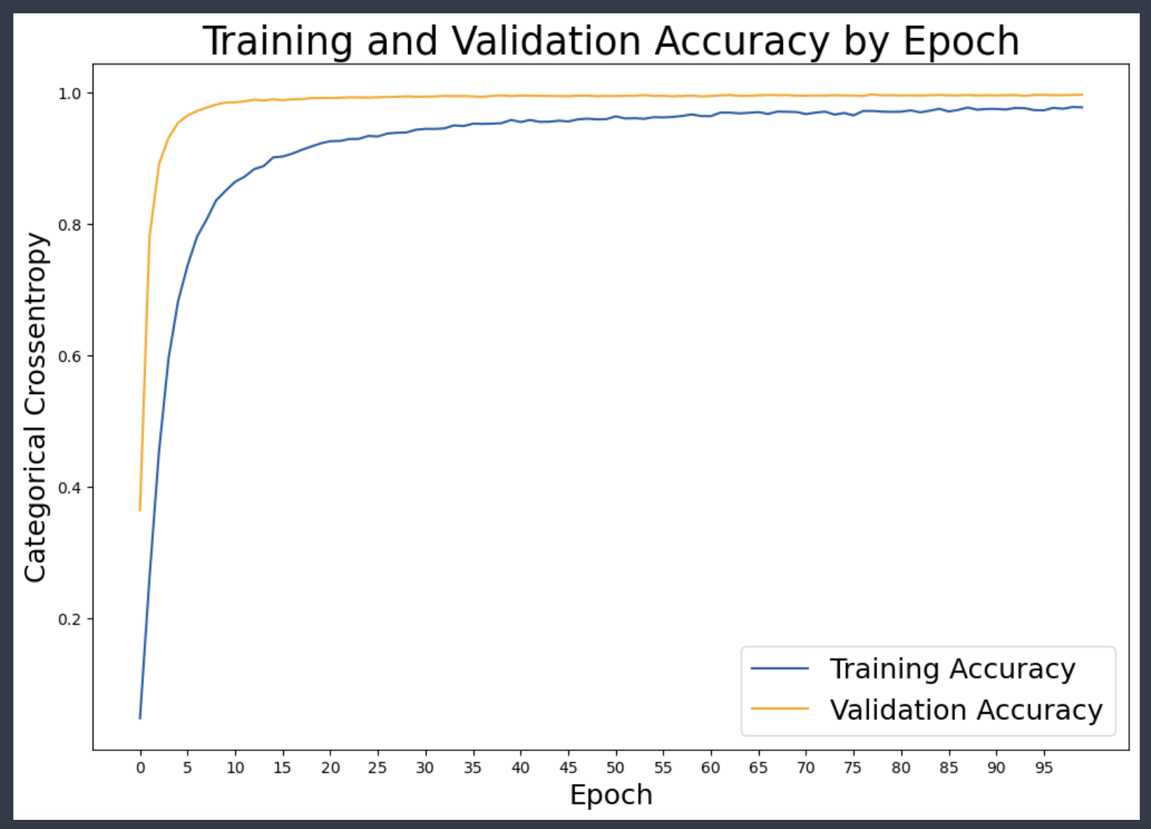
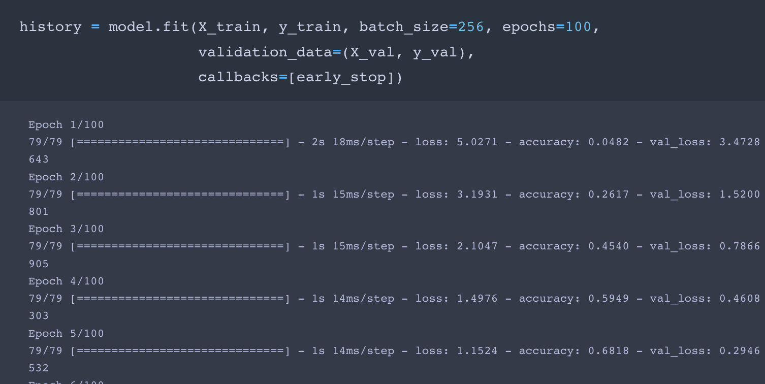
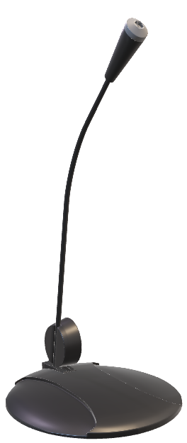
Training Process
Audio Classification
Created Neural Netwrok (Sequential Model) with 4 connected layers
Compiled with adam optimizer and categorical_crossentropy loss function (more than 2 speakers)
Training model using model.fit function
*Epoch > how many times model goes over data

Slide 8
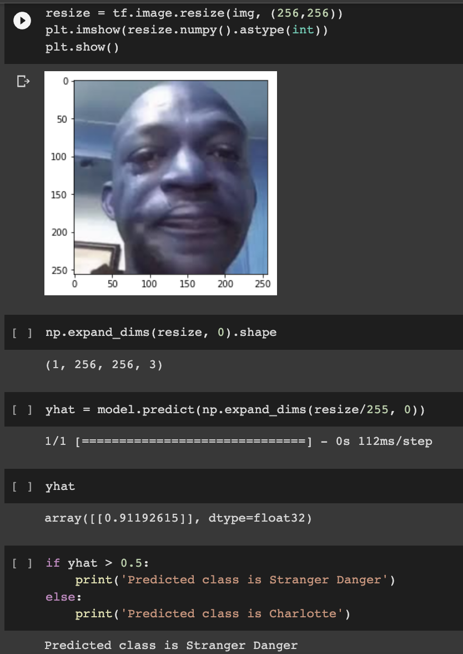
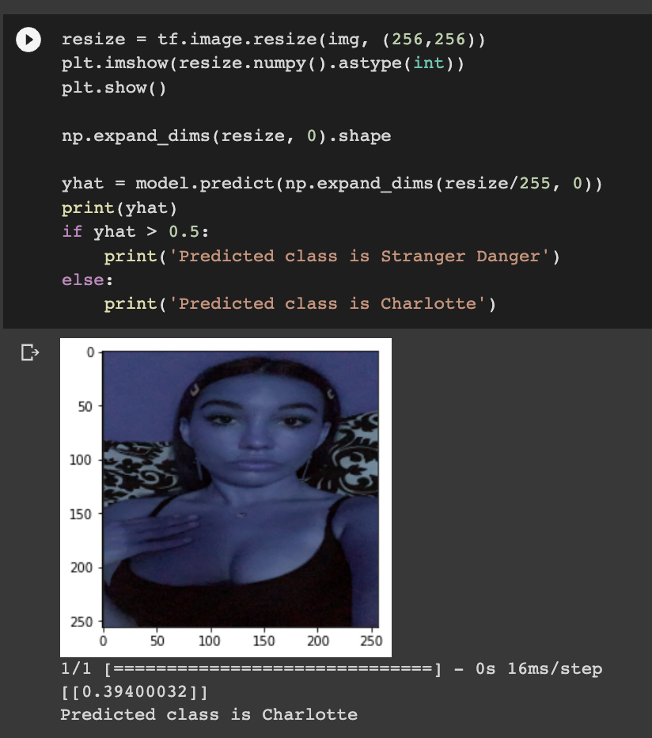


Model Evaluation
Image Classification
Accuracy 99%
Loss 0.1243
Chances of Overfitting – New images introduced to the model that are “actually” Charlotte will not be recognized

Slide 9
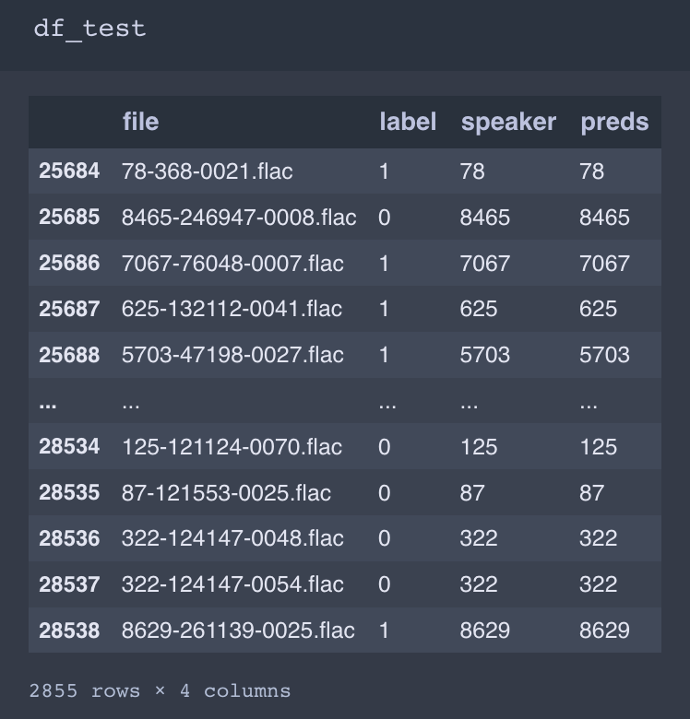
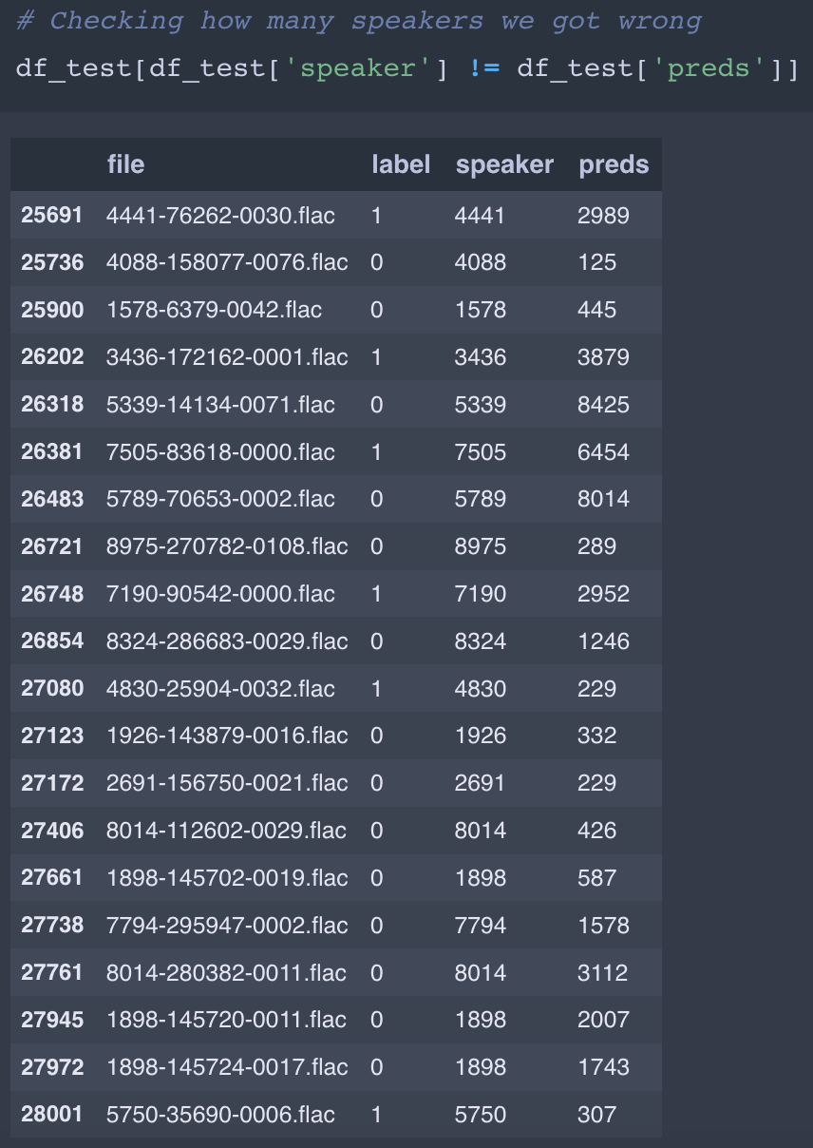
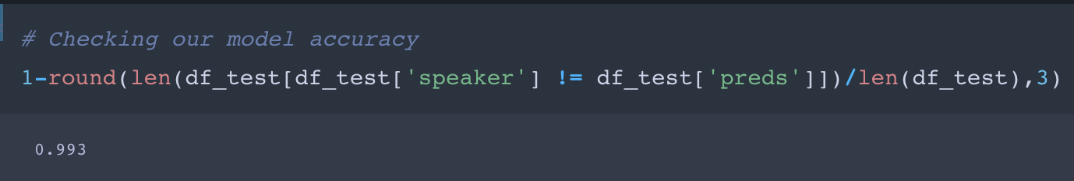
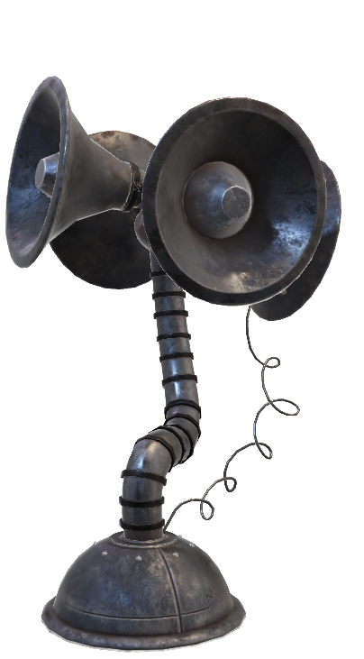
Model Evaluation
Results
Wrongly Identified
Audio Classification
Accuracy 99.3%
2,833 recordings were correctly identified

Slide 10
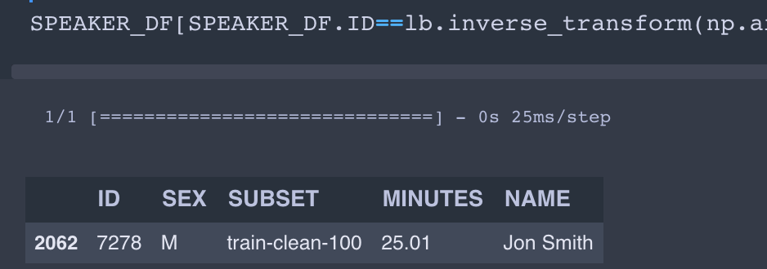



Model Evaluation
Correctly identified: Based on a new user input (used one of the recordings from test dataset)
Audio Classification
Example of accurate identification:

Slide 11

Insights & 99 Problems
CNN
Insights:
Low quality images can be functional for identifying purposes (high quality not necessary)
More data, the better the model performs
It would function better if one could have the program identify the face in a photo (manual bounding box around the face) for more accuracy
Problems:
Needs GPU (graphic card/used for graphics) which can be costly
Data processing can be lengthy to code, as each image needs to be resized, structured, etc.
Data collection is difficult in a short amount of time, which may interfere with accuracy
Audio
Insights:
Requires copious amounts of data at this point in time
Not a lot of opensource algorithms for speaker identification
Model training is relatively fast (in a few seconds can train to identify over 250 people with over 3K samples)
Very clean data = very high accuracy
Problems:
You need hrs of audio for it to work (only major corporations have access to more sophisticated algorithms that require only minutes of audio)
Small variation (e.g. background noise) can significantly reduce model’s accuracy
Gaussian Mixture Model (GMM) – Machine Learning Model that uses basic machine learning to identify different audio/voices did not work, but this could be due to lack data

Slide 12
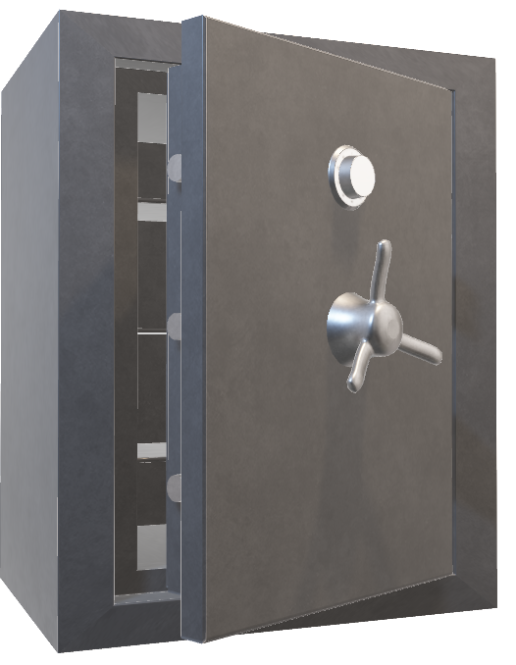
Conclusions & Next Steps
CNN
Model was able to identify the appropriate user from the “Stranger Danger” faces
Method can be integrated into a user identification program, but should be tested with more data sets.
**Will be useful for authenticator apps integrated with Fintech platforms
Audio Classification
Able to identify each unique speaker with 99.3% success rate
The downside is you need hrs of a speaker’s voice, it would be more ideal to scale this down before realistically incorporating it into an authenticator application
It would be best practice to spend more time on data preprocessing (put a filter to isolate background noises from speaker from the recording)

